Slide 1
Housing Price Predictions
Submitted By,
Rajashri.N
DBA17013

Slide 2
Overview
The model is used to predict housing prices.
Firstly the data is loaded and checked for any skewness. Then a box-cox transformation is done. Linear regression is done on the transformed data. The ridge estimates are used to check for multicollinearity. Using principal component analysis the regression is done using optimal components to reduce residual error. Partial least square technique is then used to improve the model parameters.

Slide 3
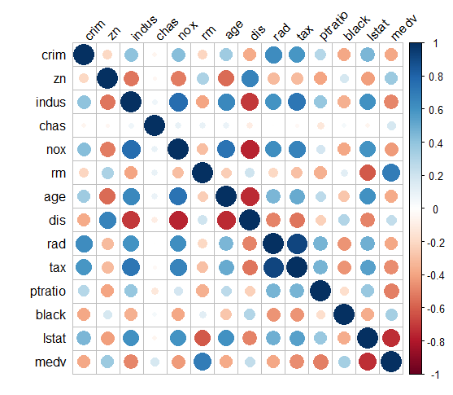
EDA
Since this data set has all numerical values ,using Correlations plot to check for correlations.
Plot with blue dots show correlations. Factors like rm,age,dis,ptratio seems to be important from the plot. Lets see!

Slide 4
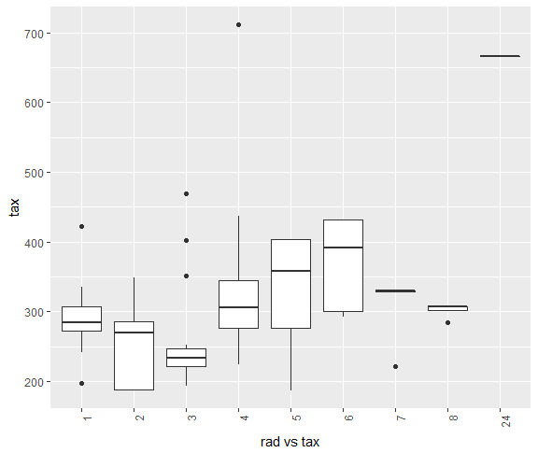
library(dplyr)
datagp1 %>% select(rad, tax) %>% ggplot(aes(factor(rad), tax)) + geom_boxplot(range = 0) + theme(axis.text.x = element_text(angle = 90, hjust =1)) + xlab('rad vs tax')
##plots show rad levels 1,2,3 have lesser tax compared to other levels
##There are few rad levels with high taxes especially 4 & 24

Slide 5
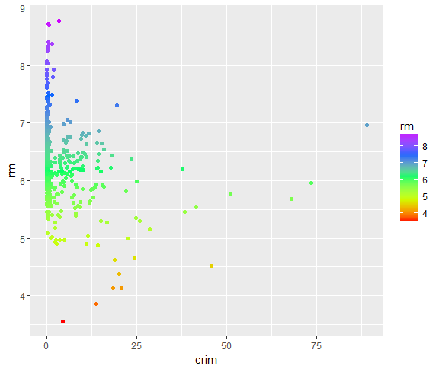
sp3<-ggplot(datagp1, aes(x=crim, y=rm, color=rm)) + geom_point()
sp3
sp3+scale_color_gradientn(colours = rainbow(5))
##rm is between 5 & 7 for crim between 0 to 25 .

Slide 6
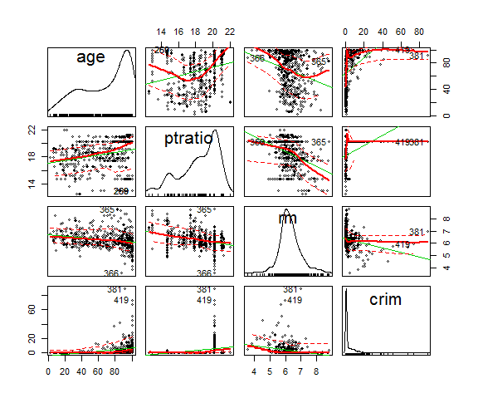
library(car)
scatterplotMatrix(~age+ptratio+rm+crim, data=datagp1, id.n=2)
##shows factors with their distributions

Slide 7
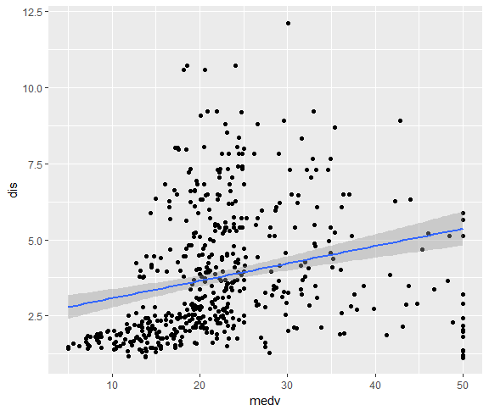
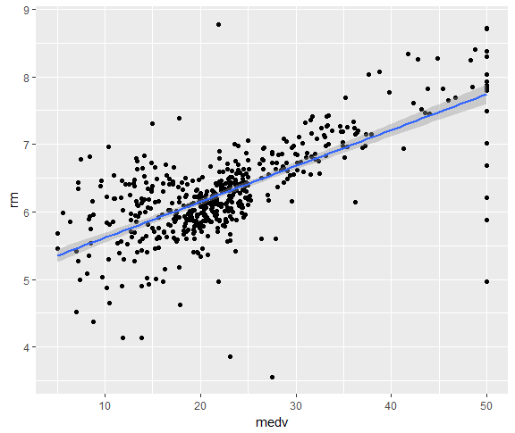
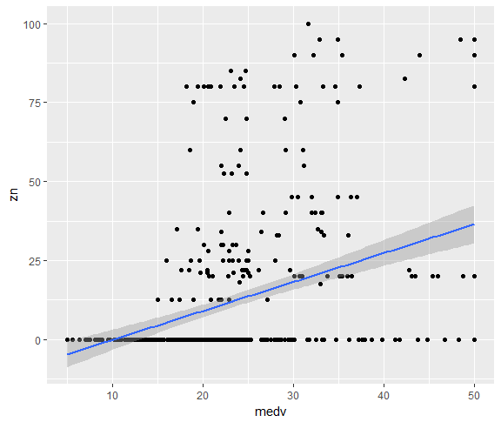
Checking linear relationship between medv and other factors identified by corrplot - zn,rm&dis are positively related.

Slide 8
Simple Model
Plain trial and error method using significance stars in summary to identify key variables for lm model.
Model # | Formula | Metrics
1 | Medv ~ . | R.Squared – 0.72 Train RMSE – 4.5 Test RMSE – 8.25
2 | medv ~ rm+age+dis+tax+ptratio+black+lstat | R.Squared – 0.68 Train RMSE – 4.96 Test RMSE – 6.2
3 | medv ~ rm+age+dis+tax+ptratio+lstat | R.Squared – 0.62 Train RMSE – 5.4 Test RMSE – 8.3

Slide 9
The trial and error method seems to be less reliable to pick the variables using stepwise regression and looking for AIC.
Best AIC using forward – 1174.37 i/p all values
Best AIC using backward – 1180.32 i/p all values.
But we cannot input all the variables as given by AIC,we should identify the important variables.

Slide 10
Observations
Data Observation,
1.Data has no null values.
2.Data is of different scales
3.Skewness is observed.
4.Data shows correlations between variables.

Slide 11
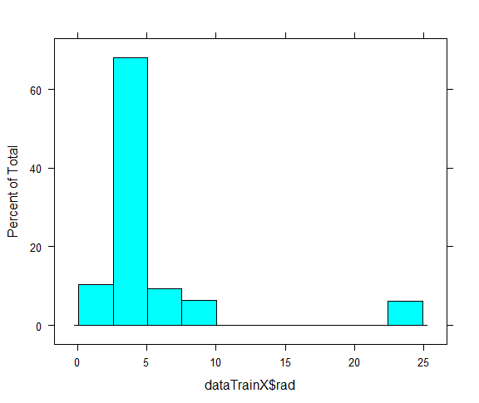
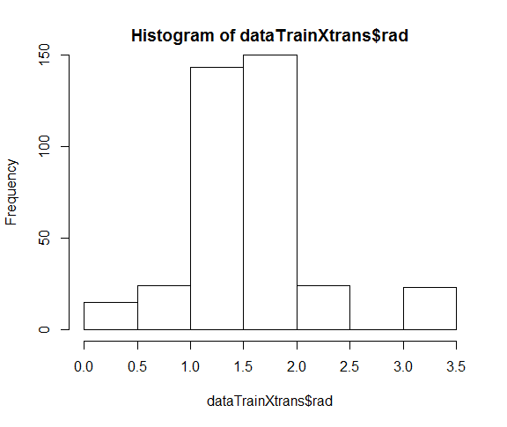
Transformation
-First scaling the data to remove skewness using Box Cox transformation
Before scaling After Scaling
histogram(dataTrainX$rad) hist(dataTrainXtrans$rad)

Slide 12
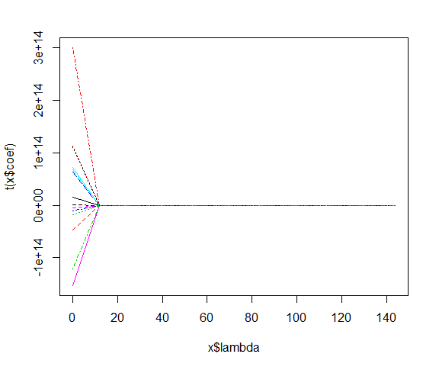
Ridge Regression – Multi collinearity Check
Using Ridge Regression Model,
ridge<-lm.ridge(medv~.,data=trainingData,lambda =seq(0,150,by=12))
##Plot shows multi collinearity exists.

Slide 13
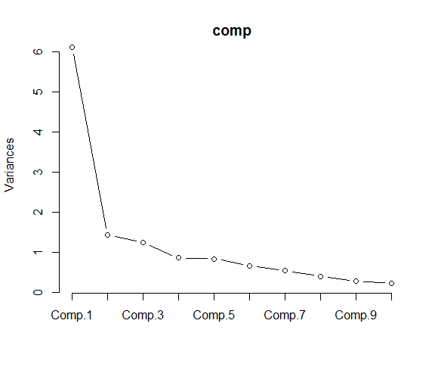
Principal Component Analysis
Using PCA and identifying important variables.
PCA Summary shows first 3 components are having eigen value 1 and hence they are used in model building.
RMSE – 0.083,RMSE has improved after PCA.

Slide 14
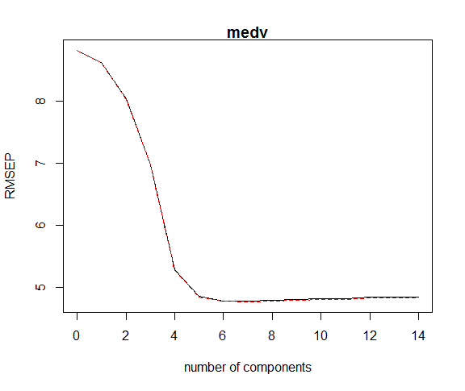
Partial Least Squares Regression
Using Partial Least Square Regression,
plsFit<-plsr(medv~.,data=trainingData,validation="CV")
pls.pred<-predict(plsFit,datatestXtrans[1:5,],ncomp=1:3)
##This model shows that there are five components explaining 90% variance.

Slide 15
Thank you!!

